Slide 1
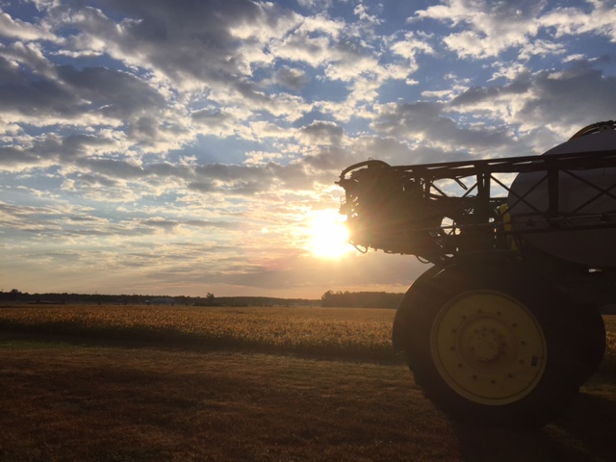
A Little about Our Classroom
Classroom Procedures
Consequences for Not Following Procedures
Expectations
Grading

Slide 2
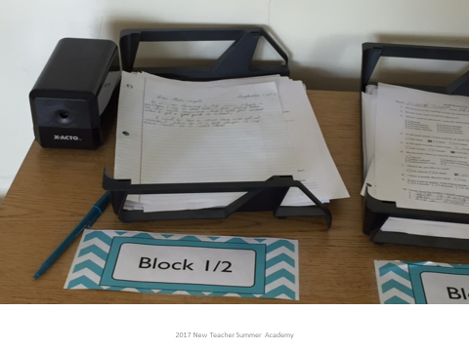
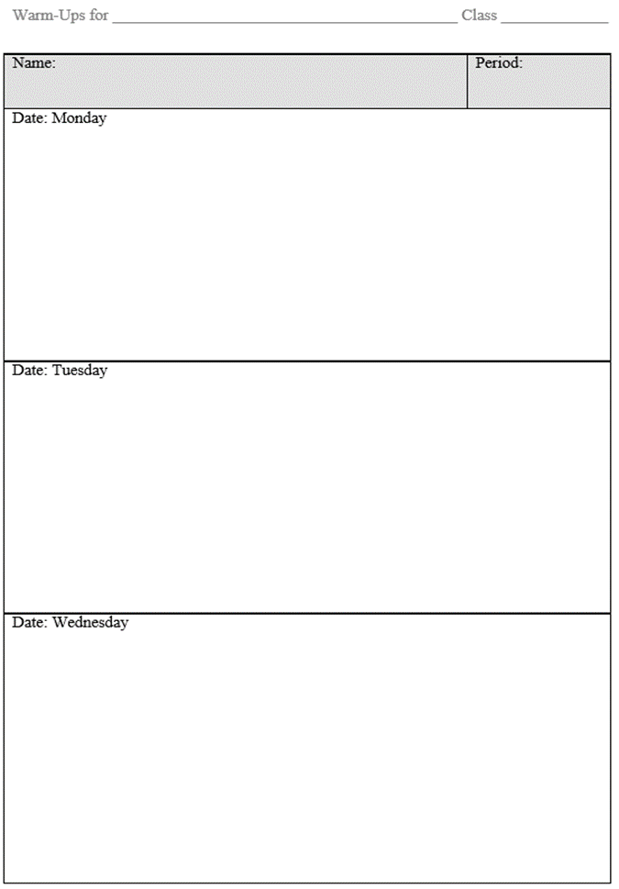
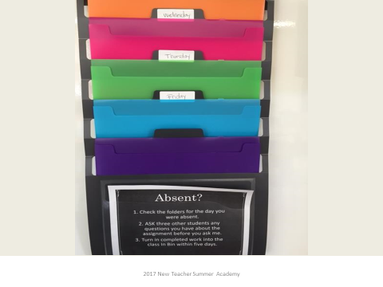

First-Day Procedures
Starting class EVERY day:
STUDENTS:
  Prepare materials/sharpen pencils
  Turn in make-up work/get make-up work
  Take out warm-up sheet and homework
  Be seated when the bell rings
  Check phone for last time, silence it, and store it

Slide 3

First-Day Procedures
Starting class EVERY day:
TEACHER:
  ATTENTION
  Tardiness
  Welcome
    Opening slide with directions and reminders

Slide 4



Slide 5
First-Day Procedures
Starting class EVERY day:
TEACHER:
  ATTENTION
  Tardiness
  Welcome
    Opening slide with directions and reminders
  Warm-up directions/attendance
    Purpose, grading, collection
  Timed work

Slide 6

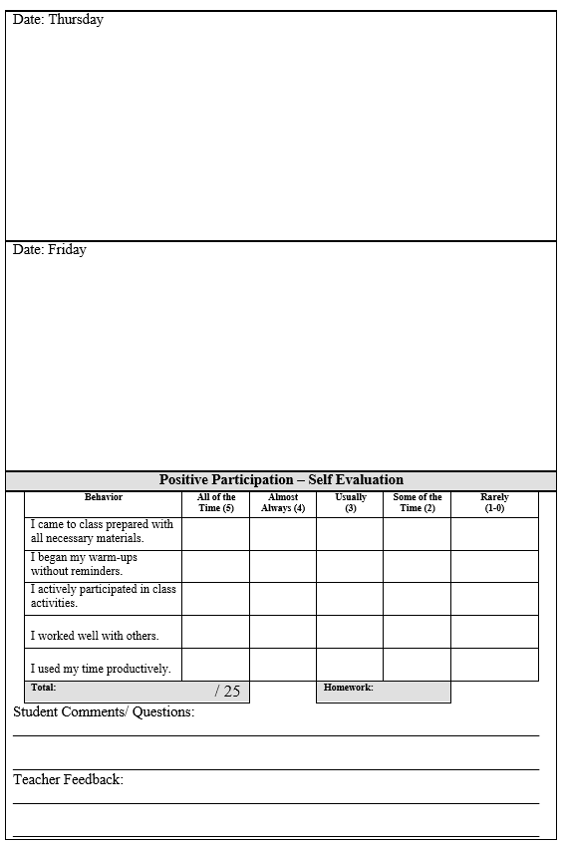
Warm-Up Sheets

Slide 7
First-Day Procedures
Asking and answering questions:
  Are they relevant to what we’re doing?
  Will they benefit the whole class?
  Raise your hand, please.
  Is it an emergency?
Taking care of personal needs during class
  Raise your hand, please.
  After directions and/or instruction; during independent work
  We follow the 10-10, school-wide rule.

Slide 8
First-Day Procedures
Collecting papers
  Pass to right.
  Point person at end checks for names.
  Point person places all papers in labeled bin.
End-of-class routine
  Check for understanding
  Reminders/preview next day
  Clean up area.
  Check cell phone.
  At teacher’s dismissal, push in chairs.

Slide 9

First-Day Procedures
Cell phone use
  Beginning and end of class
  Instructional purposes
  NO charging
  If needed, teacher will store in secure location.
  Infractions have same consequences as disregarding other procedures.
  Be fully present.

Slide 10
Management vs. Discipline
Procedures help you know how to get things done and keep all people and the classroom and school environments safe.
Choosing to disregard guidelines results in consequences.
  Warning
  Guideline Infraction Notice
  Communication with home
  Intervention and/or detention
  Office referral

Slide 11
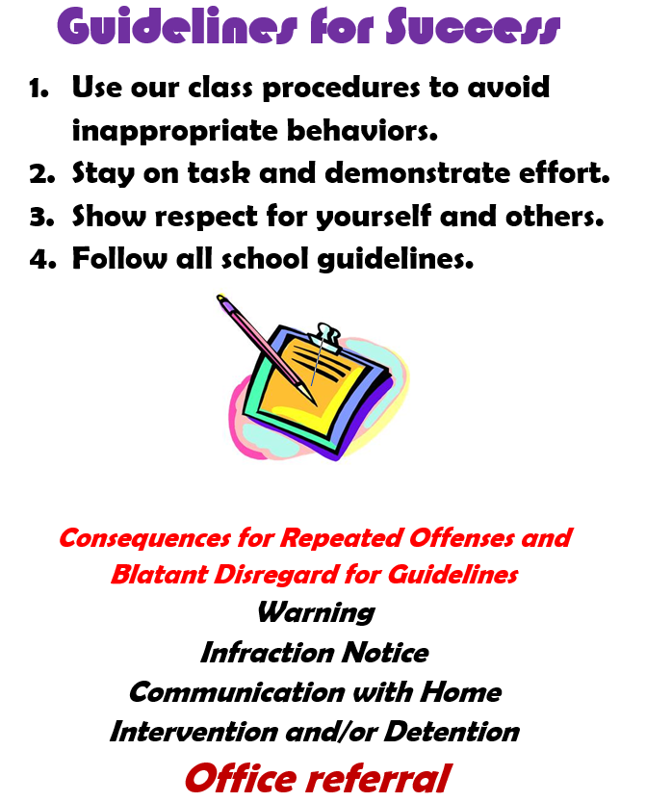
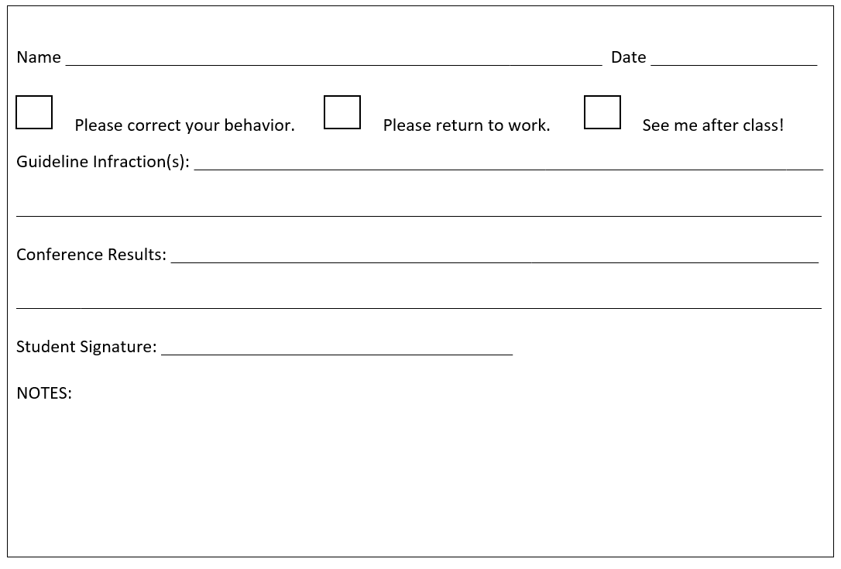
Management vs. Discipline
1
BE PROACTIVE for YOUR SUCCESS.
INFRACTION NOTICE
2

Slide 12
Effort, Willingness, Application
Be committed to practicing listening, speaking, and writing – a lot! EFFORT MATTERS.
Be open-minded and willing to embrace differences:
  Beliefs and values
  Use of language
  Other people’s life stories
Be looking for ways to connect the material.

Slide 13
Grading
New Policies!
Grades accessible in Parent Portal mid-September through the last day of the year
Minimum of two grades every six days
Grades consist of formative (50%) and summative (50%) assessments
  Formative assessments occur as learning occurs: participation, classwork, homework, group work, exit tickets, informal writing, etc. Are you learning the material?
  Summative assessments occur at the end of an instructional period: quizzes, tests, projects, formal writing, etc. Did you learn the material?

