Slide 1



Put Me In Coach,
I’m Ready to Teach
Wicomico County
New Teacher Induction Program

Slide 2
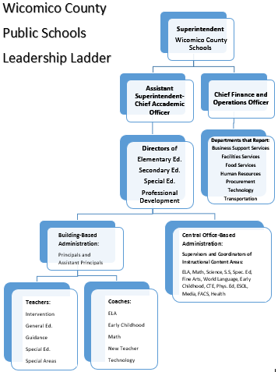
Structure of Support
New Teacher Coach
Office staff
Custodians
Team leaders, department chairs, lead teachers
Special Education teachers, assistants
Instructional coaches
Guidance counselors and support staff
Administrative team
Supervisor

Slide 3

Coaching Champions!
Open communication through frequent visits and discussions
Identify the current reality
Identify strategies to integrate
Mediate, observe, model
Explore and refine
Video and other data collection
Reflect, research, create
Best practices that support Common Core
Coaching conversations, data collection, and co-teaching

Slide 4
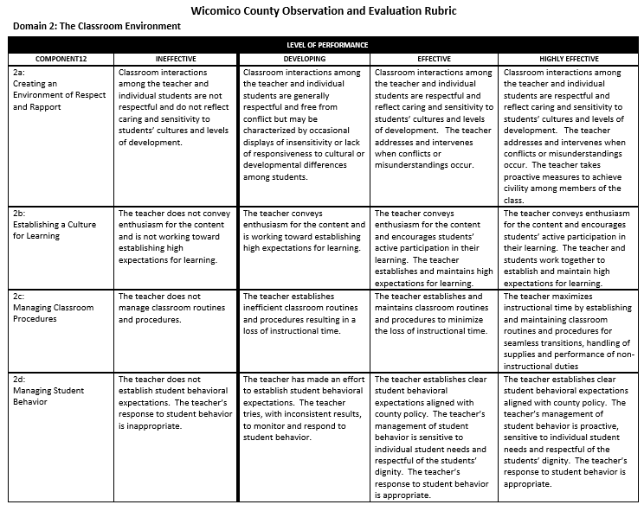

Slide 5
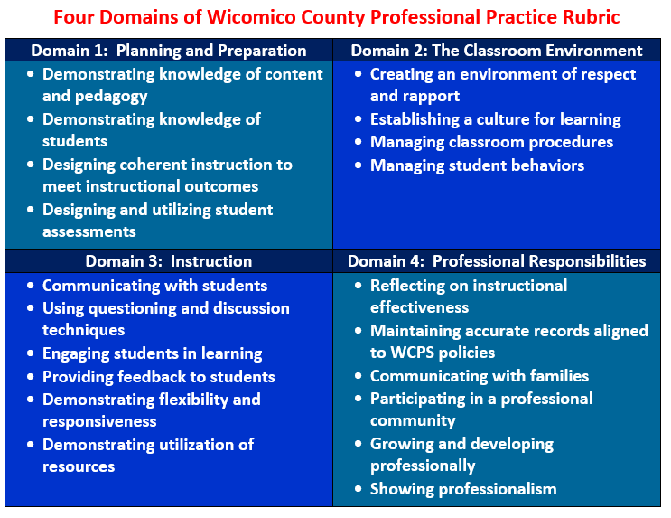

Slide 6
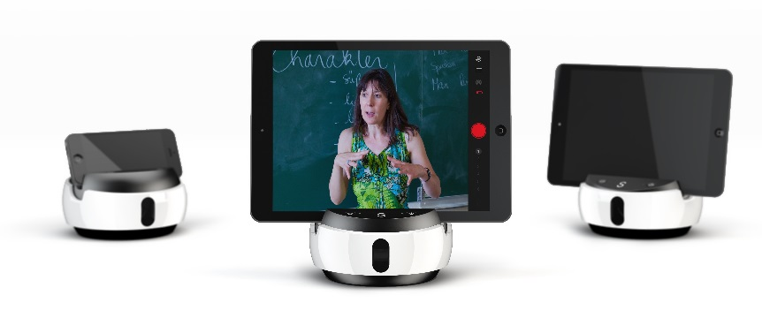


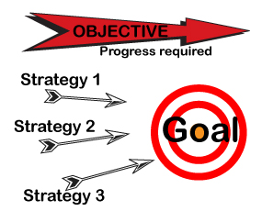


Our Equipment

Slide 7



How often will I see my new teacher coach?
How will communication occur?
What professional development will I receive?
Create a Partnership

